Slide 1
We Care

Slide 2
1. Introduction
1.1 Purpose
1.2 Scope
1.3 Definition
1.4 References
1.5 Overview

Slide 3
2.General Description
2.1 Product Perspective
2.2 Product Functions
2.3 User Characteristics
2.4 Constraints
2.5 Assumptions

Slide 4
3.Specific Requirements
3.1 Functional Requirements
3.2 Non-Functional Requirements
3.3 Hardware Requirements
3.4 Software Requirements

Slide 5
3.1 Functional Requirements
Register
Description : This function will help the visitor to make account in this app to be followed in his health status and communicate with his/her doctors.
Response : Redirect to home page.
Purpose :Validate his input.
Input : His name, age, location, his Job, profile picture, username and password.
Output : If the entered data wasn’t used before to register, he will be registered and redirected to home page. If not, he will be redirected to login page.

Slide 6
3.2 Non-Functional Requirements
Legal
This app can’t take idea or tools from other app. this app save your privacy from other people and make you private with your friends and tracker.
Security
Our developers work hard and a lot to make high quality of protection for this app to help you to use this app and be comfortably. This app is made for you to keep track of your health with your doctor and tracker with total privacy.
Performance
This company ensures to you easy handling and fast performance. Our developers mainly mission is to improve the performance of the app.
Maintenance
Our software engineers work on testing and debugging this app and we works every time to maintain this app and help to have our user satisfication.

Slide 7
3.3 Hardware Requirements
This app will be available first for android devices the IOS devices, It won’t need to much power to perform well, So a mid-range smart-phone will do just fine.

Slide 8
3.4 Software Requirements
In this app we use database with objects and it could be supported and controlled. Our developers make this app to work in maximum number of platforms.

Slide 9
4.Result
4.1 The problems of current system
4.2 The solution of system problems

Slide 10
4.1 The problems of current system
01 -More than one function can do the same functionality.
02- Could be a complex application for old people (our age target).
03- Needs a lot of resources when “Code Red“ is activated (in need only).
04- The application have a lot of functions and that maybe confuse some users (like excel).
05- The application must be compatible with many different operating system and compatible with multicable versions of same operating system.

Slide 11
4.2 The solution of system problems
01- We will make every function have a special job to do.
02- We will try to simplify and make tutorial for our application.
03- Will try to use less resource in the “Code Red“.
04- Will explain every function in our program to make it most useful for users.
05- Our developer will do their best to make it able to work on every platform.

Slide 12
5.Appindices
5.1 Glossary
The Tracker : The person Who Keep up with the patient situation, Usually is a relative of the patient. e.g, The tracker would be the parents if the patient is their child.
“Code Red” : This is an emergency button which would send the patient location to the hospital to send an ambulance, send a notification to the patient’s doctor/tracker, call a pre-selected number of near person asking for help.

Slide 13
Diagrams
DFD
Context level
Level 0
ERD
Level 1

Slide 14
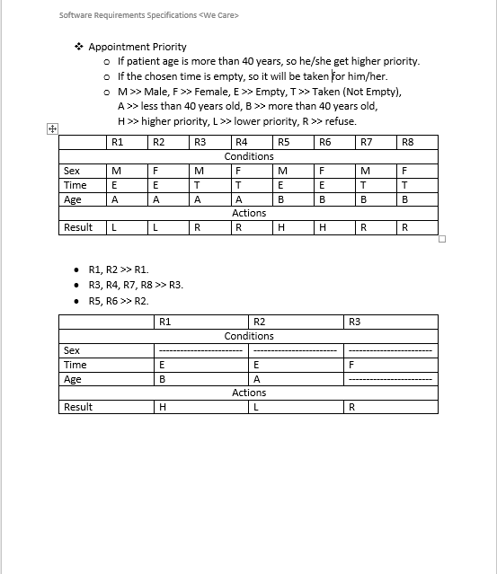
Dissection Table

Slide 15
Data Dictionary
Entity
Data Flow
Data Store
Process

Slide 16
Data Dictionary - Process
Process Number | 1
Process Name | Manage search
Purpose | Help patients and tracker to find professional doctors with good rate.
Input data flow | Doctor’s specialization.
Output data flow | Sorted list of doctors by their rate.
Process Discerption | Patient or tracker will search on doctors with specific specialization and see their profiles.
Notes

Slide 17
Data Dictionary – Data Flow
Name | Rate doctor
Description | Make feedback for doctor from patient
Origin | Patient tracker
Destination | Serve doctor

Slide 18
Data Dictionary – Data Store
Name | Users info
Symbol | D1
Description | Store list of users that use this system.
Data item | Text
Record place | Users list
Authorization | Patient, Tracker, Doctor

Slide 19
Data Dictionary – Entity
Name | Patient
Input | Rate doctor, search, chat, book an appointment, send take medicine notification, add tracker, accept doctor tracking and send code red.
Output | Receive notification and prescription.
Description | He make account , search on doctors by their specialty, communicate with doctors, take appointment, get prescription, rate doctor and receive notification about every changing in the system that is related to him/her.

Slide 20
Data Dictionary - ERD
Entity Name | Entity Description | Column Name | Columns Description | Data Type | Length | Primary Key | Nullable | Unique
Patient | Patient is someone who use application | Name | Patient’s name. | Varchar | 30 | False | False | False
 |  | ID | Unique identification number in records. | Integer | 10 | True | False | True
 |  | Sex | Identify the patient gender. | Boolean | 1 | False | False | False
 |  | Birth Date | Age of the patient. | Date | 8 | False | False | False
 |  | Phone Number | Contact number with patient. | Varchar | 15 | False | True | False

